Slide 1
Containerization with Kubernetes

Slide 2
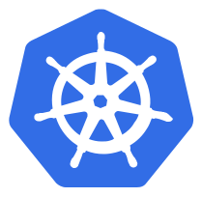
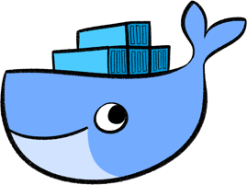
Content
What is containerization?
Docker is and what it is for
What is Kubernetes?
Kubernetes features
Pods
Controllers
A k8s Service
Volumes
Namespace
Kubernetes Demo

Slide 3
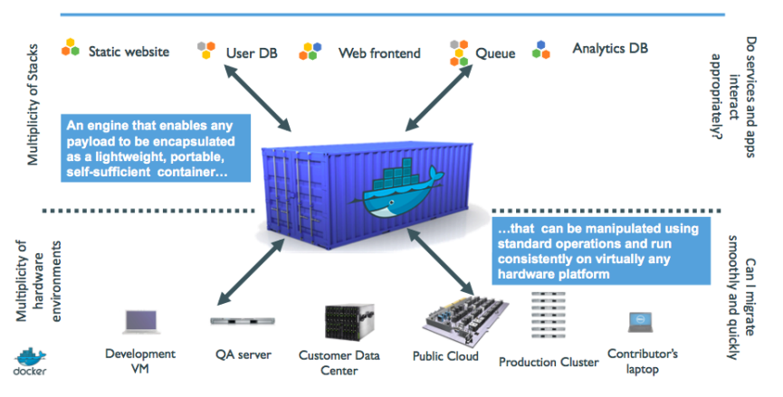
What is containerization VS ?

Slide 4
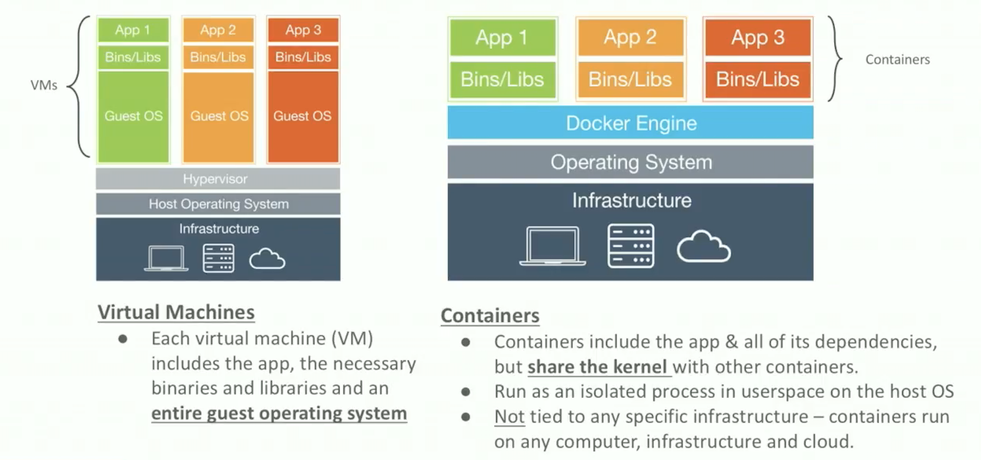
VM vs Containers

Slide 5
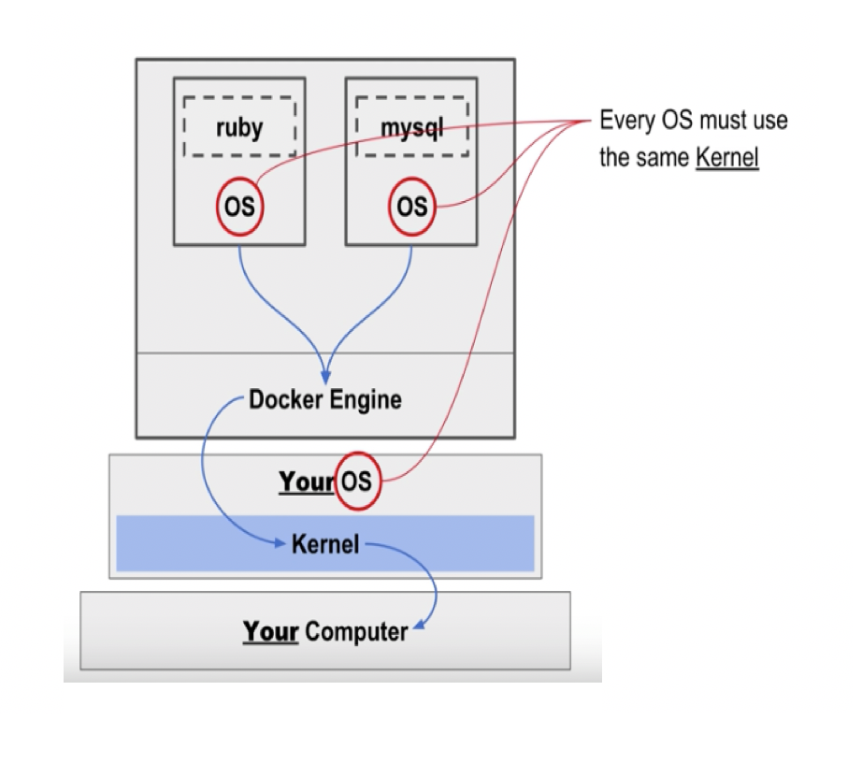

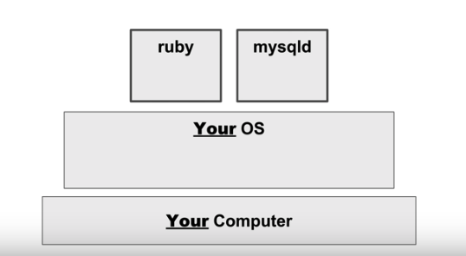
Docker
the default container runtime engine, makes it easy to package an application and push it to a remote registry where it can later be pulled by others.

Slide 6
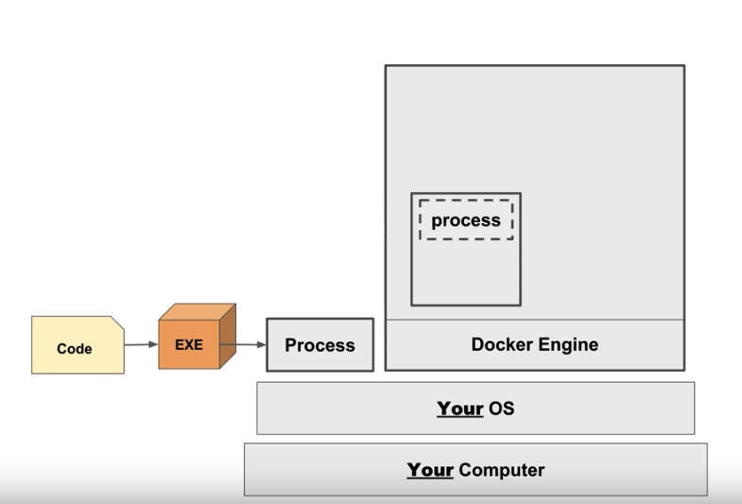
What is Docker, and Key Concepts

Slide 7
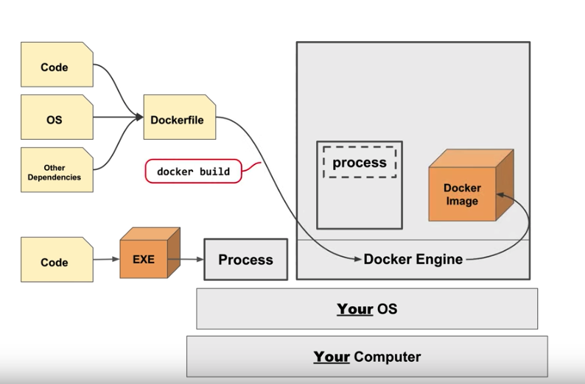
Images
Layers
Containers
are conceptually similar to
Classes
Inheritance
Instances

Slide 8
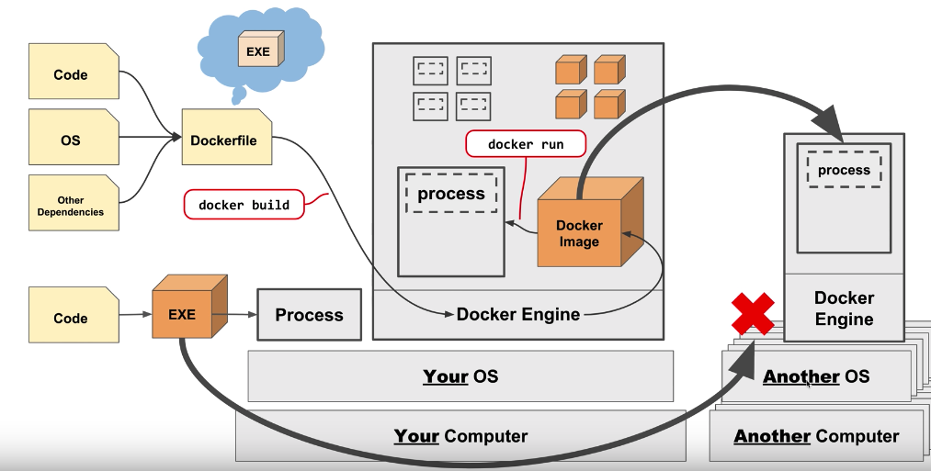
Images
Layers
Containers
are conceptually similar to
Classes
Inheritance
Instances

Slide 9
Kubernetes
is an open source orchestrator for deploying containerized applications.
Deploys multiple containers either by themselves or as a part of an application across many hosts.
Has the ability to link containers together so that they can communicate with their peers.
Exposes required containers as services to the world outside the cluster.
Scales the cluster up or down.

Slide 10
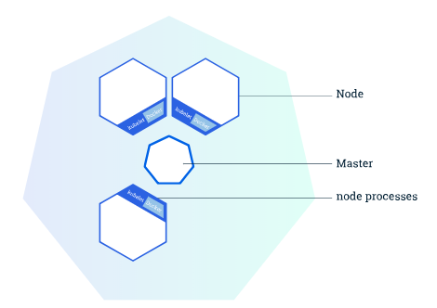
Kubernetes Cluster
coordinates a highly available cluster of computers that are connected to work as a single unit.
K8s cluster consists of two types of resources:
The Master coordinates the cluster
Nodes are the workers that run application
Master manages the cluster
Node is a VM or a physical computer that serves as a worker machine in a Kubernetes cluster

Slide 11
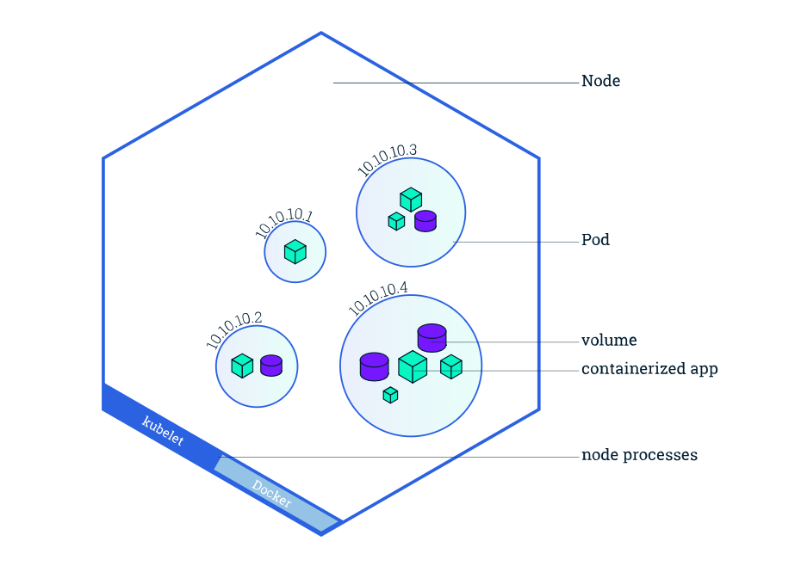
Pods
the simplest unit that you can interact with. You can create, deploy, and delete Pods, and it represents one running process in your cluster.

Slide 12

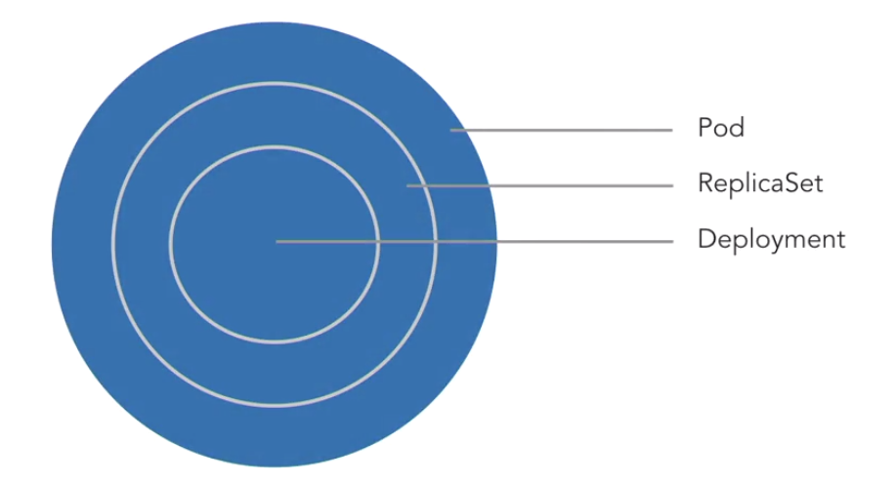
Controllers
ReplicaSets
Deployments
DaemonSets
Jobs
Services

Slide 13
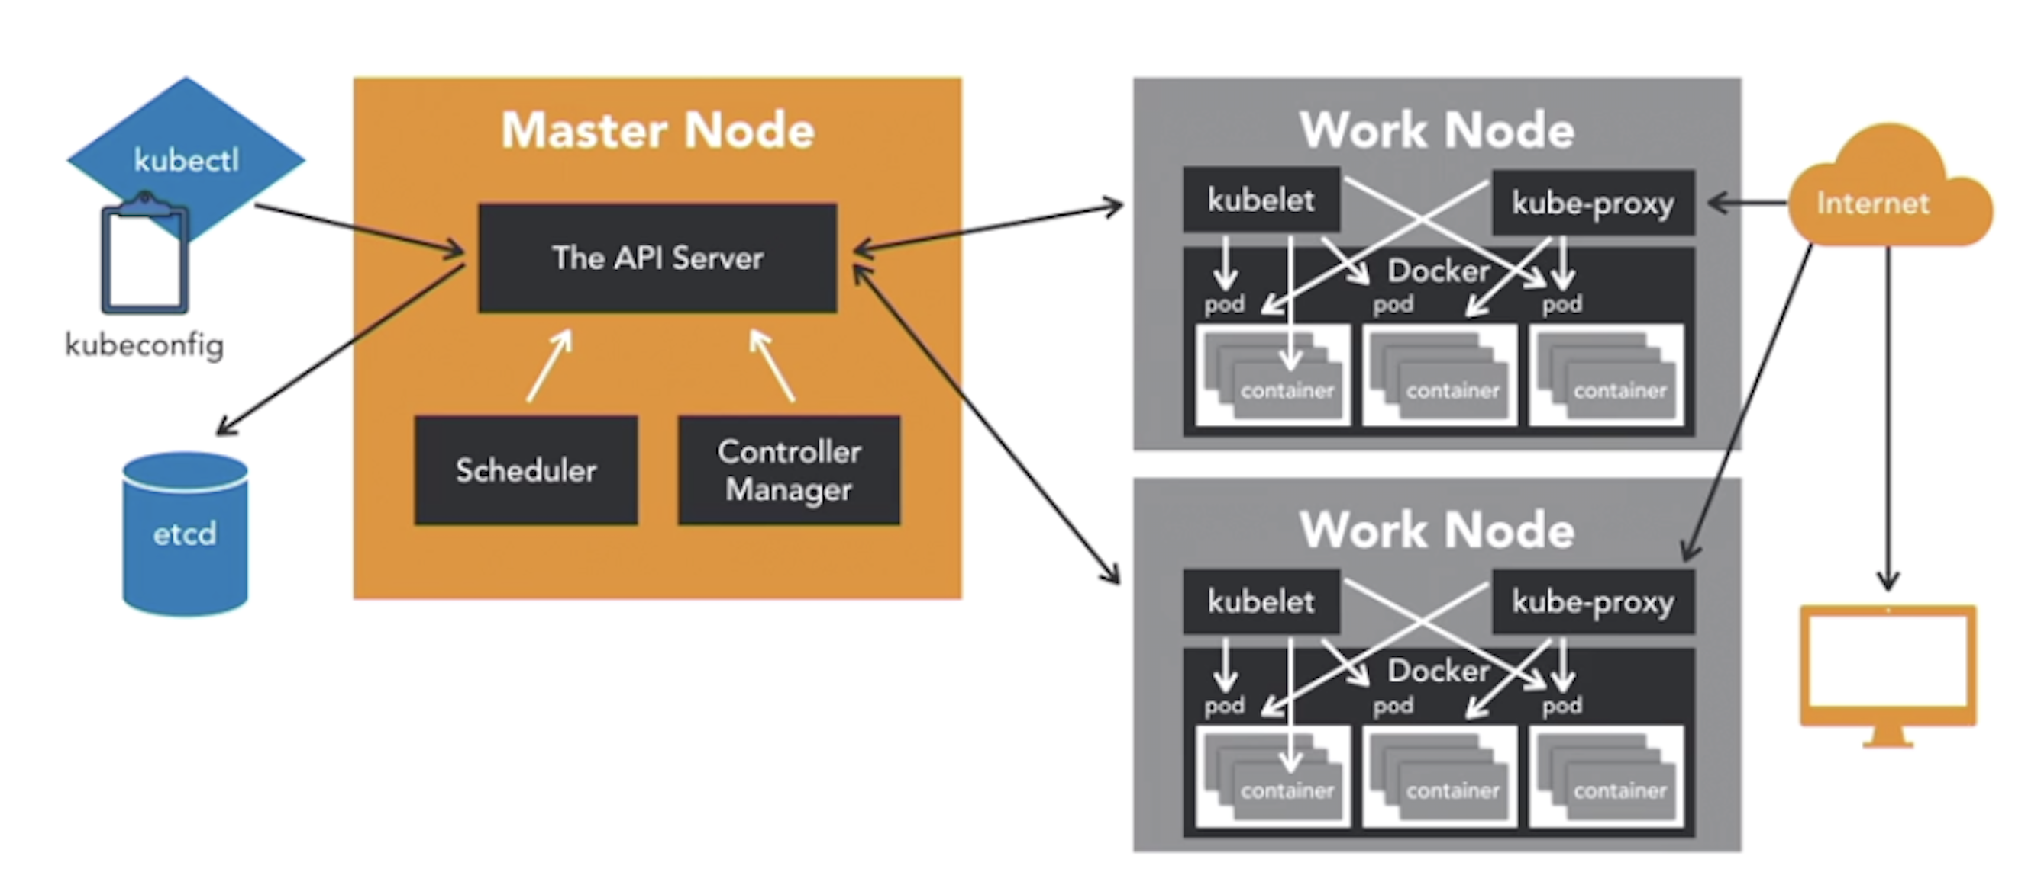
ARCHITECTURE

Slide 14
KUBERNETES HELLO WORLD demo
https://github.com/KseniiaRyuma/kubernetes_demo

Slide 15
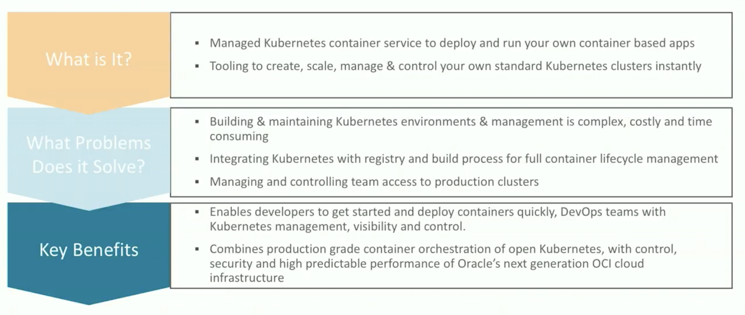
Oracle Container Engine

Slide 16
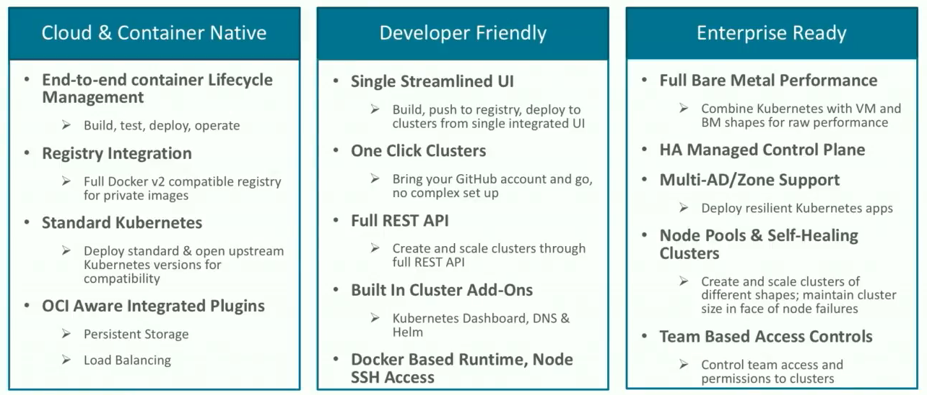
WHY Oracle Container Engine?

Slide 17
Resources
https://kubernetes.io/docs/tutorials/
http://wiki.zenoss.org/download/core/drich_slides/DockerSlides.pdf
http://images.i.mesosphere.com/Web/Mesosphere1/%7B99d70011-92e7-44bf-b00b-4774fcab232b%7D_running-kubernetes_oreilly-ebook.pdf
https://docs.oracle.com/en/cloud/iaas/container-cloud/contu/getting-started.html

